Slide 1

DIGITAL IMPLEMENTATION OF SNAKES AND LADDERS
B.M.S COLLEGE OF ENGINEERING
Bull Temple Road, Basavanagudi, Bangalore - 560 019, Karnataka, India
MANU SARAOGI – 1BM18EC076
MARK AASHISH – 1BM18EC077
VISHNUPRIYA BHARADWAJ – 1BM18EC182
YASHO MANGAL N – 1BM18EC188
Under the guidance of
Bhavana H T
Assistant Professor
Mini Project
2019 – 20
Department of Electronics and Communication Engineering

Slide 2

Introduction
Corporate jobs come with good pay packages and promising perks. However, companies fail to address the work-stress based anxiety experienced by employees. Excess work load and peer pressure doesn’t let them give time for recreational activities. Light activities in work space serve as a good means of reducing stress.

Slide 3
Scope of project
Mental health of an employee is a matter of concern for the employer as well as the family. It is important for an employer to address work-stress related issues and provide for ways to overcome the same. However, it becomes challenging for corporate offices located in the heart of the city to provide for sports as a means of recreation.
Such a scenario calls for an alternative which is an equally effective stress buster . One such alternative is Board Games. They not only act as an effective stress busters but also build cognitive skills and help in the growth of the immune system.

Slide 4
Problem definition
We propose our project as an effective solution, addressing the earlier identified problem in the best possible way. We present to you the evergreen board game- The Snake and Ladders.
The digital version of the game has been designed based on the core concepts of Digital Electronics.
Initiative by a corporate office to address work stress and provide for recreational activities helps the company to make a mark and set standards amongst its competitors.
The project is an added advantage for product promotions during industrial visits in IT/Electronic sector Multinational Companies, aiding the growth and development of the company.

Slide 5
Rules of the Game
1) This game can be played by two players.
2) Each player has a total number of 16 boxes to complete in order to win. This game consists of one snake and one ladder.
3) The ladder is placed at position 3. It directly shifts the players position to 7.
4) The snake is placed at position 9. It shifts the players position back to 2.

Slide 6
5) Each player gets alternate chances to play. The player is suppose to start and stop the dice by pressing ‘S'. Once the dice is stopped the number on the dice is displayed. Now the player will have to press the ‘SPACE' key in order to move to the new position as well as switch the player.
6) The same player cannot play twice continuously.
7) The electronic dice shows numbers ‘0’,’1’,’2’, and ‘3’.
8) Suppose the player is currently on position 13 or 14, he/she will have to get a dice number of 2 or 1 respectively in order to land on 15th position.
9) If the player gets a number greater than the above given dice numbers, they enter an addition loop where in they will again have to come from the start. For example, suppose the player is on 14. He gets a dice number 3. His new position would be 1.
10) The first player to reach 15th position wins and this is indicated with a yellow glowing led.

Slide 7
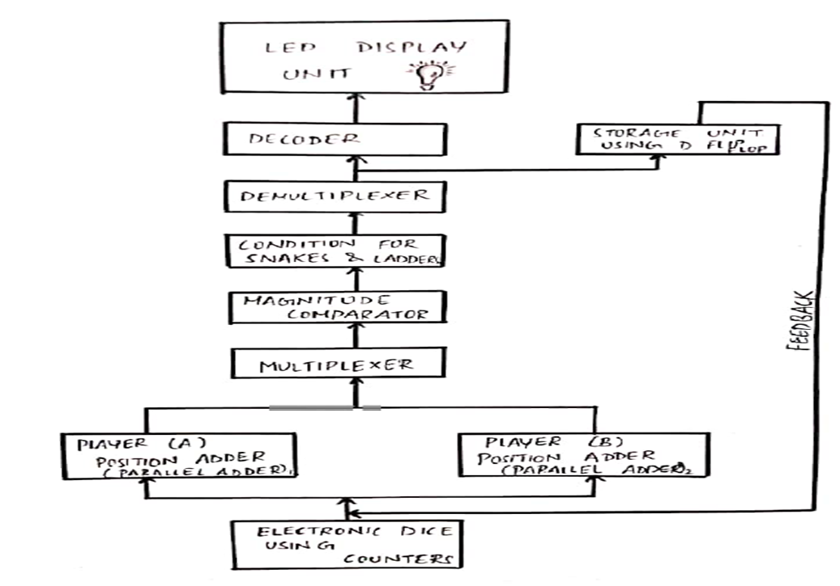
Proposed solution
The block diagram shown represents the flow of events in the circuit which eventually shows us Snake and Ladders can be implemented digitally using the concepts that we have studied. The simplified , expanded form is shown below.

Slide 8
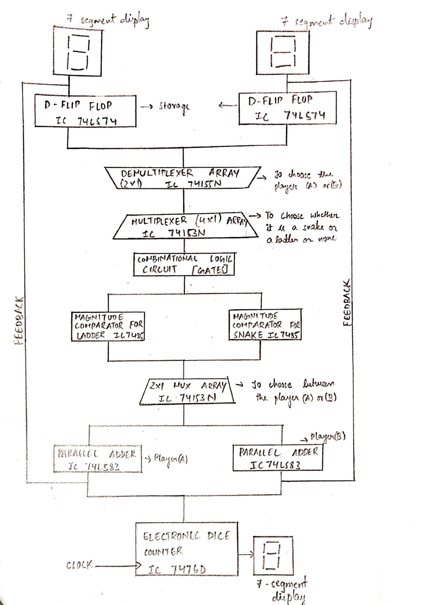

Slide 9
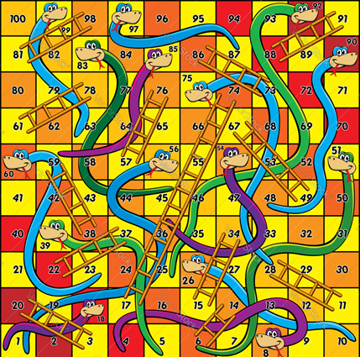
As in the traditional game of Snake and Ladders , the game’s most important feature is the dice so for our circuit we have designed it using a synchronous counter with a high frequency clock.
The digital implementation follows an array of different combinational circuits which serve the purpose of functioning of the Snake and Ladder.
The condition of whether it’s a Snake or a Ladder is checked using magnitude comparator and parallel adders.
Once the position of the player is updated it is stored using D flip flops so that it can be given back at the input for the player’s next turn.
The output is shown on a seven segment display which is inturn connected to an LED which turns on when someone wins the game.

Slide 10
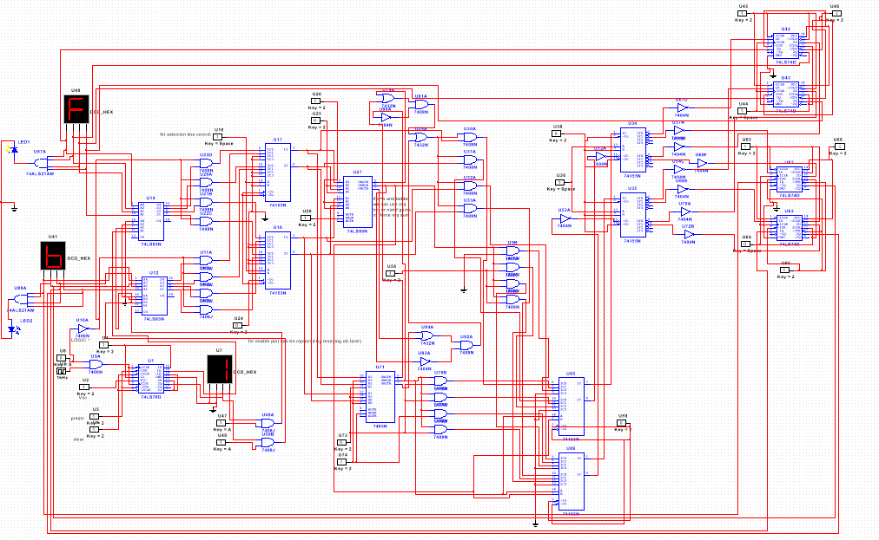
CIRCUIT DIAGRAM

Slide 11
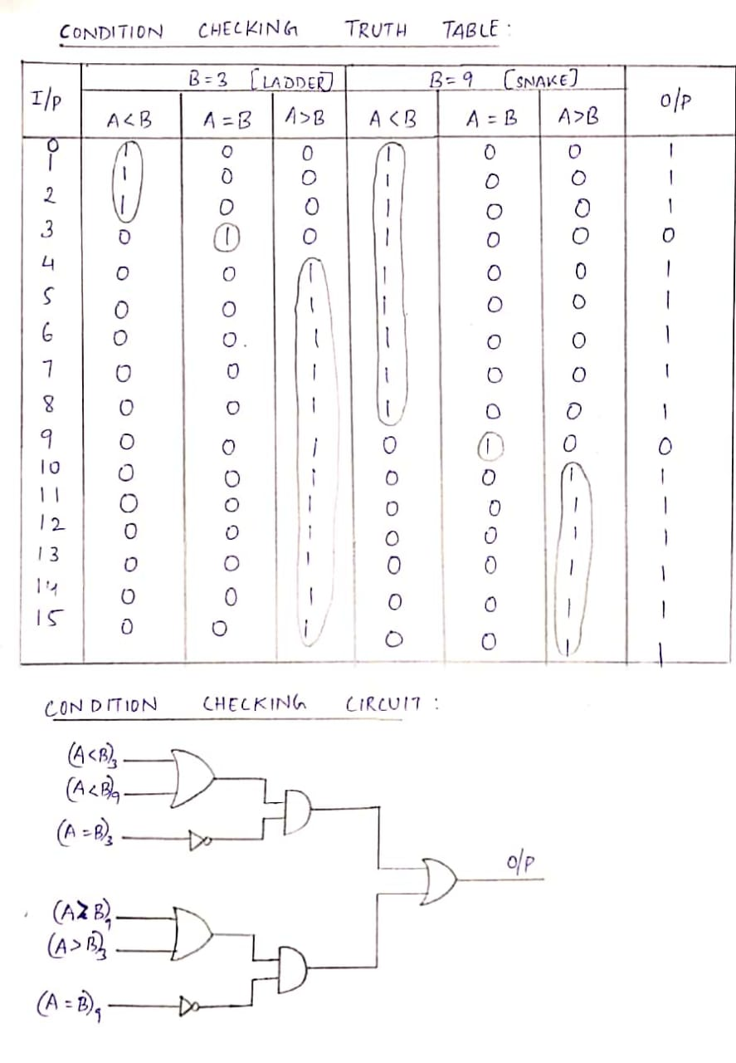

Slide 12
Project planning
Task | Description week | 1 | 2 | 3 | 4 | 5 | 6 | 7 | 8 | 9 | 10 | 11 | 12 | 13 | 14 | 15
1 | Topic selection
2 | Designing of circuit
2.1 | Electronic Dice
2.2 | Control Circuit
 | a.Adder
 | b.Magnitude Comparator
 | c.MUX, DMUX
 | d. Decoder
2.3 | Storage unit:
 | D- Flip Flop
3 | Report and ppt presentation
4 | Internal Evaluation
5 | External Evaluation

Slide 13
Expected outcomes
This would act as an effective solution for stress at electronic and various other industries.
It also would act as a good advertisement for the manufacturing company during industrial visits.

Slide 14
Estimated Budget

Slide 15
Advantages
No prerequisites required to play this game as it involves very simple ground rules and hence is not mind bogging.
Acts as a good stress buster and an advertisement in electronic and IT sector companies.
Helps in building cognitive skills and also helps in refreshing our mood.
Low cost with respect to IT and Electronic sector companies.

Slide 16
Reference(Literature survey) details
Books
“Digital Design ” by M. Morris Mano and Michael Ciletti
Web-resources:
components101.com
dnatechindia.com
www.futurlec.com
electronics.stackexchange.com
Youtube and other sources

Slide 17
Thank you

